Slide 1
ENSE 470 - Milestone 4
Timbits
Maksym Zabutnyy, Earl Macalino, Jennifer Herasymuik
March 1st, 2018

Slide 2
Database Snapshot
Using knowledge gained from the ENSE 353 Lab:
Made a Redhat server
LAMP stack
Used AWS to create server
Database is MariaDB
Since it’s free
Using PHPMyAdmin

Slide 3
Database - Data Cleansing
Used an Excel Document to cleanse data:
Copy & Pasted both files into sheet
Reformatted the rows (Text to columns)
Sorted all data to remove duplicates
Duplicate names, software name or acronyms (~85 rows to 75)
Used pivot table
Formatted to be just like Table setup
Import the CSV file into PHPMyAdmin

Slide 4
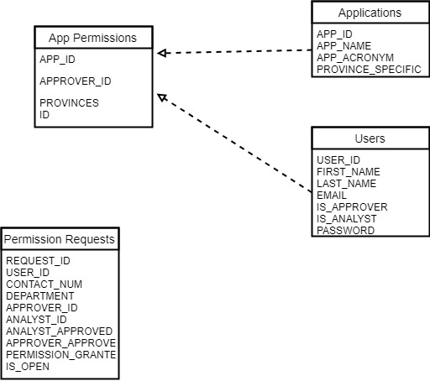
Database - Diagram

Slide 5
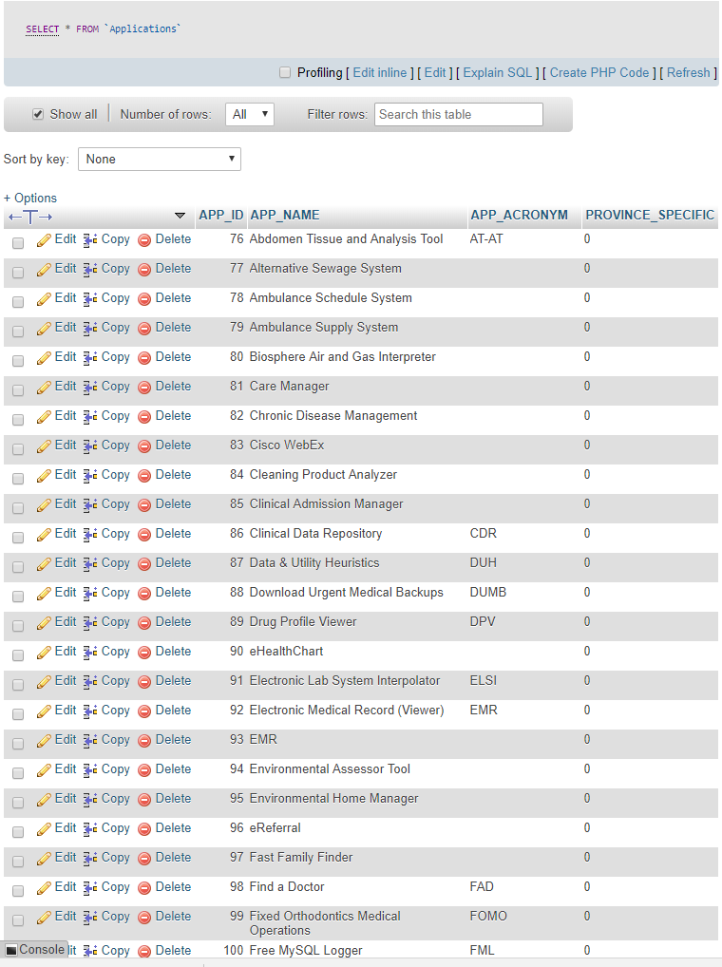
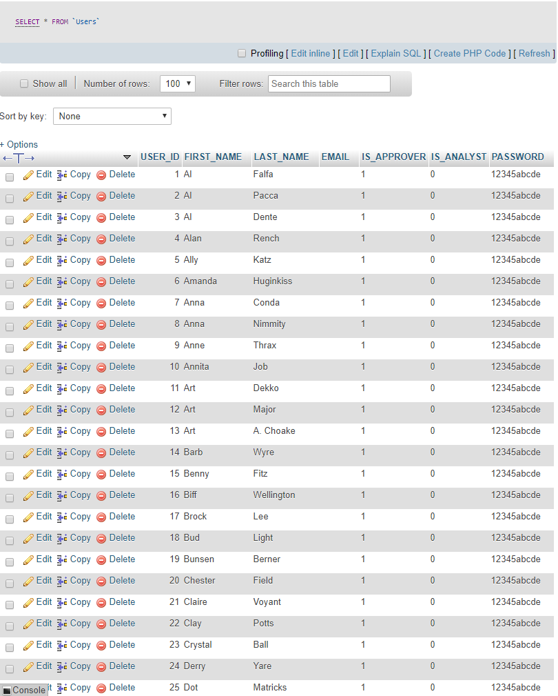
Database Tables

Slide 6
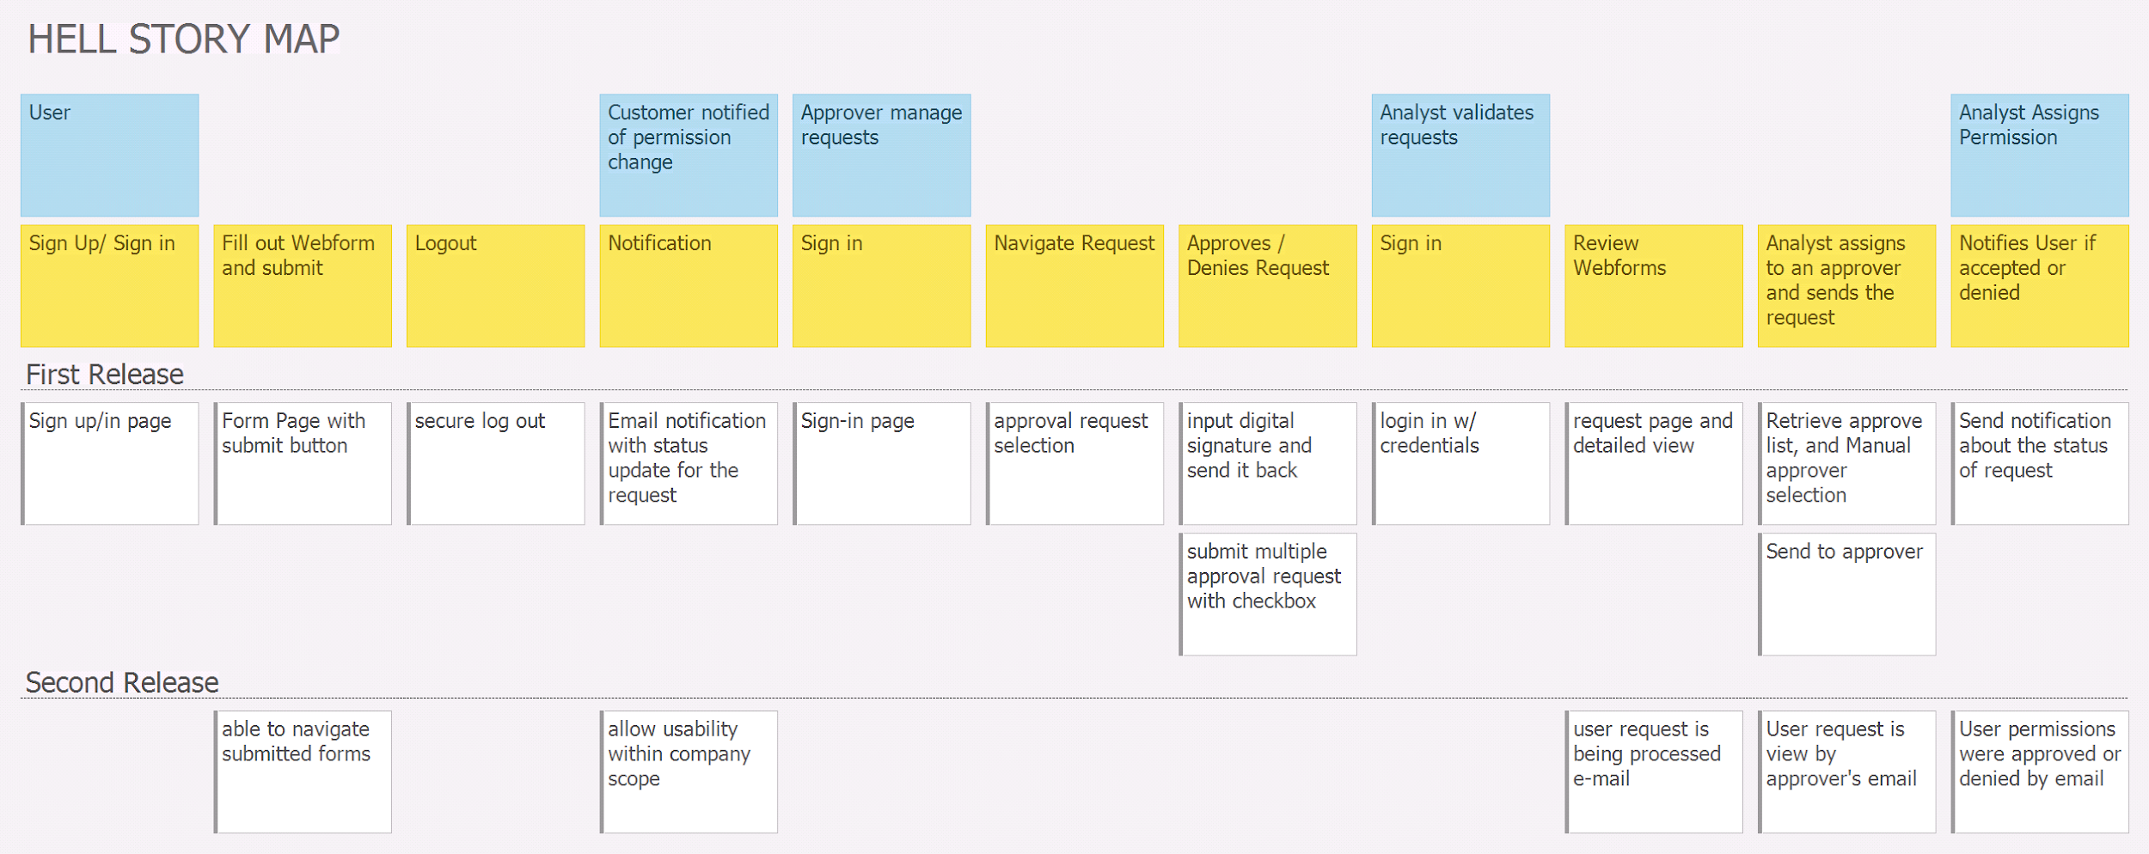
Recall: User Story Map

Slide 7
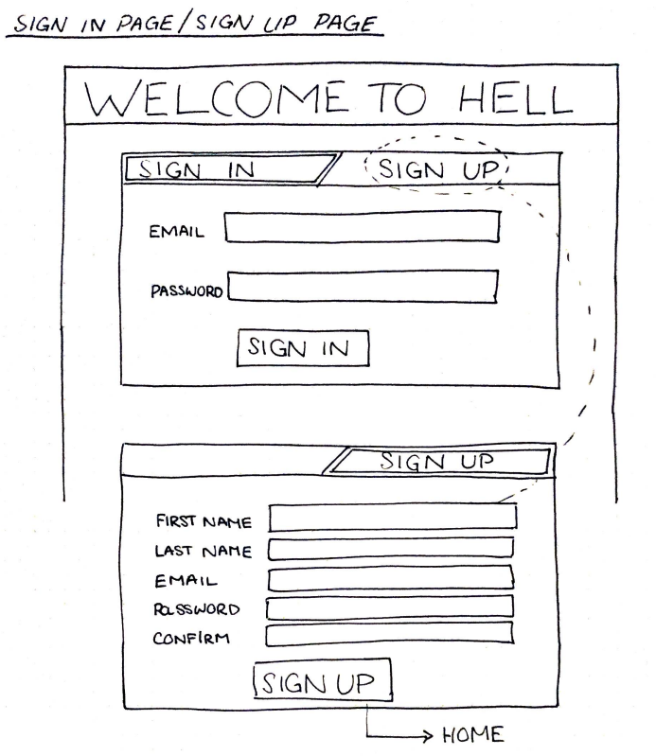
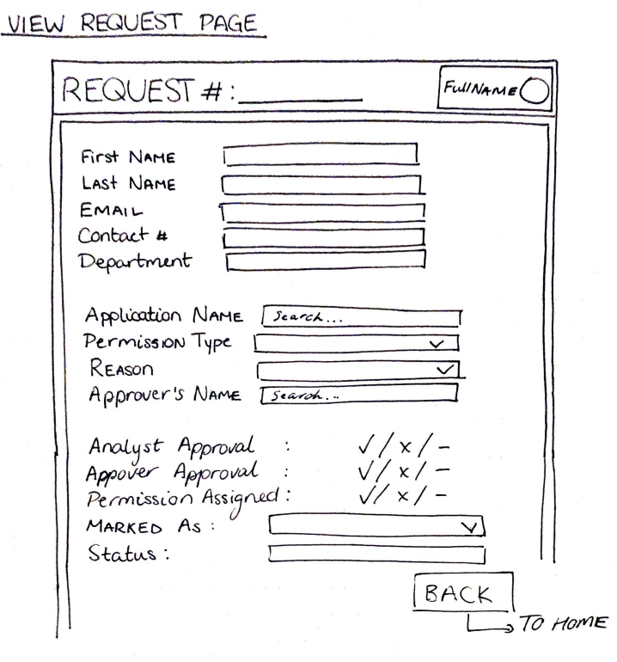
Lo-fidelity Prototype

Slide 8
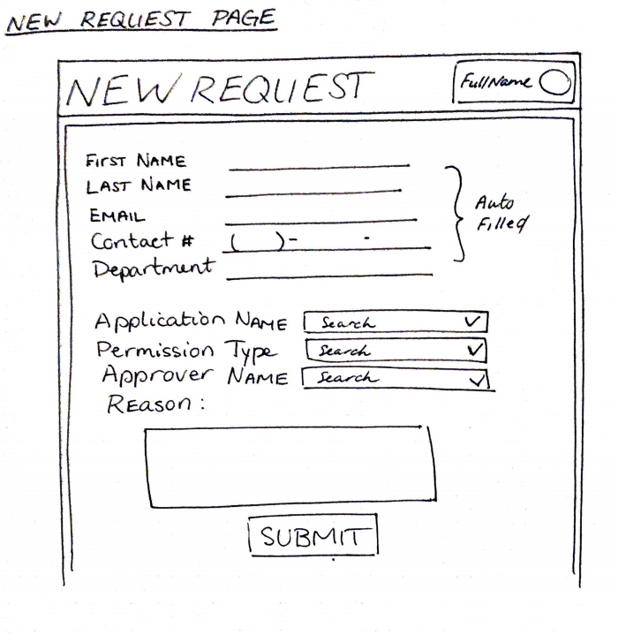
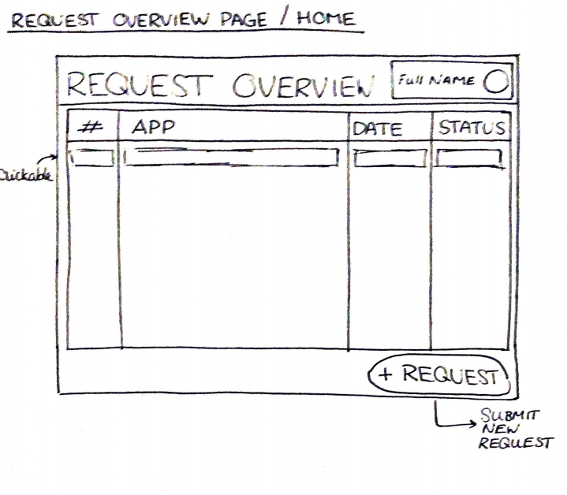
Lo-fidelity Prototype

Slide 9
Creating the Lo-Fidelity Prototype
Used pen and paper, Wave Rocketbook
Pro: The benefit of lo-fi prototypes is laying out how the pages/components will look and interact. Navigation takes shape, because you are able draw the lines between the necessary pages.
Con: Tedious to draw up all the pages.

Slide 10
Changes
How plans have changed since initial conception
Not a lot has changed
Determined how we are going to select approver for request
Lots of ideas before were broad, instead of changing anything we simply nailed down the details of them
Compressing 3 user stories into one, as well a change in mvp to make it more simplified
Other insights
Number of pages greatly reduced by using the proper credentials to alter pages

Slide 11
Group Reflection
How did you feel about this milestone? What did you like about it? What did you dislike?
Fun to do some work with the database and start visualizing project. Data cleansing sucked though!!!
What did you learn about yourself through this milestone?
Should manage time better, made data cleansing tough because there was no time to explore other options.
How will you use what you have learned going forward?
Need to determine better ways to sort data. Lo fi prototyping is actually a great way to hash out minor details
What “stuff & things” related to this milestone would you want help with?
Nothing really.

